Slide 1
云计算技术
陈果 副教授
湖南大学-信息科学与工程学院-计算机与科学系
邮箱：guochen@hnu.edu.cn
个人主页：1989chenguo.github.io
https://1989chenguo.github.io/Courses/CloudComputing2018Spring.html

Slide 2
What we have learned
What is cloud computing
Cloud Networking
Physical Structure
Applications and network traffic
Host networking virtualization
Addressing & Routing
Software-Defined Networking Architecture
Decouple data plane and control plane
Killer apps
Cloud virtualization
VL2, NVP

Slide 3
Inter-data center networking
Part I: Cloud networking
Most materials from UIUC MOOC
Ankit Singla
ETH Zürich
P. Brighten Godfrey
UIUC
Credits to

Slide 4
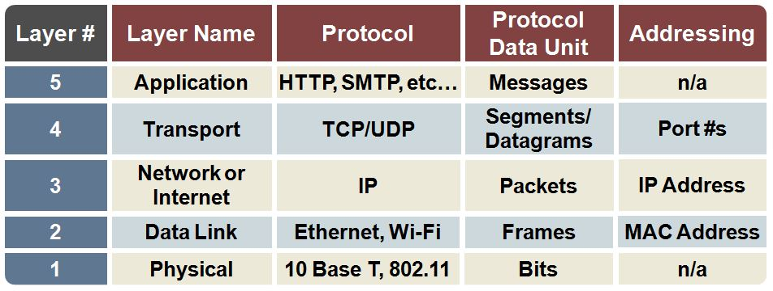
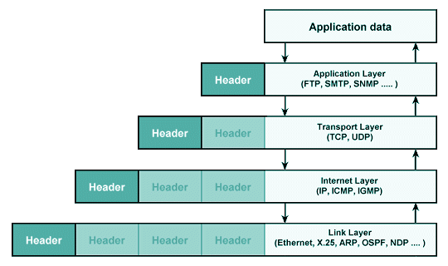
Network layer concepts

Slide 5
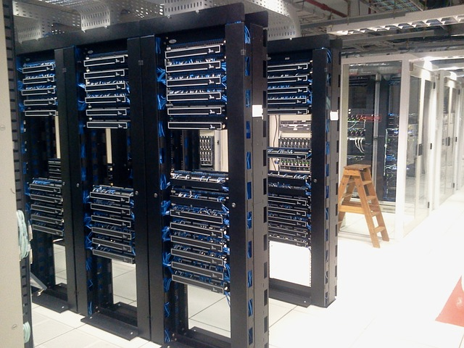

How large online services work
Notes:
Using any popular Web application today means talking to servers in a data center

Slide 6
How large online services work
The Internet
Notes:
Of course, the client’s connectivity to such data centers goes over the Internet, and is a crucial determinant of application performance.
Data centers also communicate with each other, for example, for replicating client data across multiple data centers.
When we talk about “the cloud”, wide-area connectivity over the Internet is as important as the data center infrastructure
So, in this lesson we’ll start by looking at inter-data center networking, and in later lessons, at client Internet connectivity

Slide 7
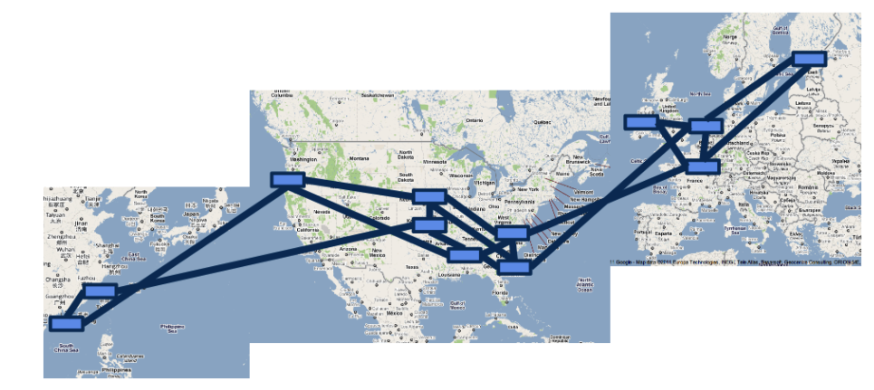
Google’s WAN (2011)
“B4: Experience with a Globally-Deployed Software Defined WAN”
Jain et al., ACM SIGCOMM 2013
Notes:
Here’s a part of …

Slide 8
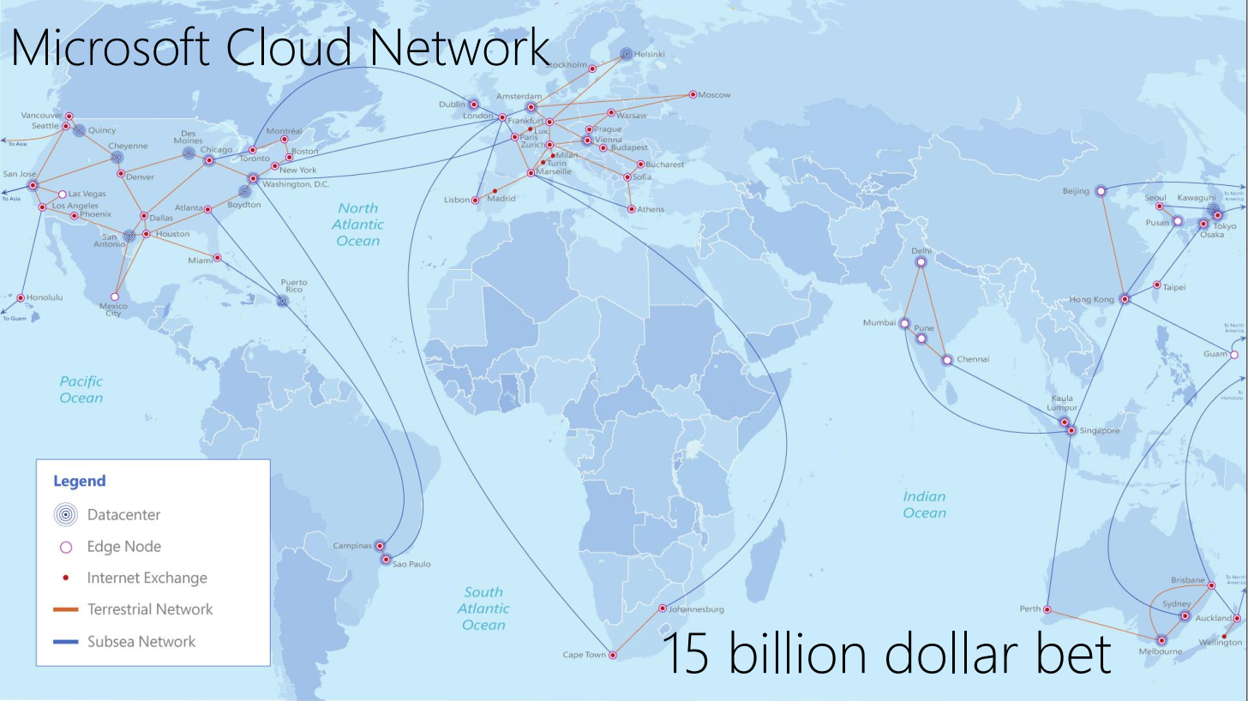
(2015)

Slide 9
Why multiple data centers?
Data availability
Load balancing
Latency
Local data laws
Hybrid public-private operation
Notes:
availability:
geographical diversity (natural catastrophes)
electrical power and Internet connectivity in different regions
massive failures in a facility
Load balancing
multiple facilities help incoming and outgoing traffic to be spread across a wider set of providers in a wider geographic expanse
mitigate DoS attacks on a facility
Latency
Can provide services close to clients in various regions
might also reduce transit bandwidth expense (carrying data over smaller distances and perhaps fewer networks)
Local laws
Data stored in Germany might be subject to German and EU data protection legislation
There might be legal obligations to store (or not store) data in a certain jurisdiction
Hybrid public-private cloud usage: for any combination of above reasons
This under the right circumstances could be cost effective: handle average service demand over private infra, offload peak demand to the public cloud

Slide 10
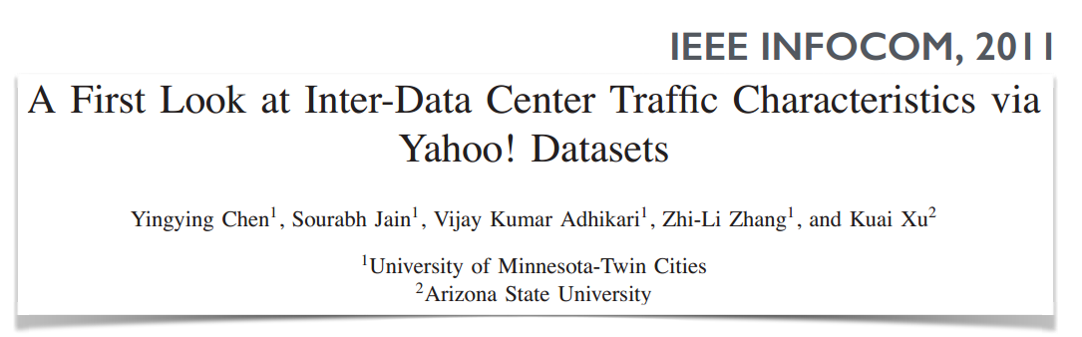
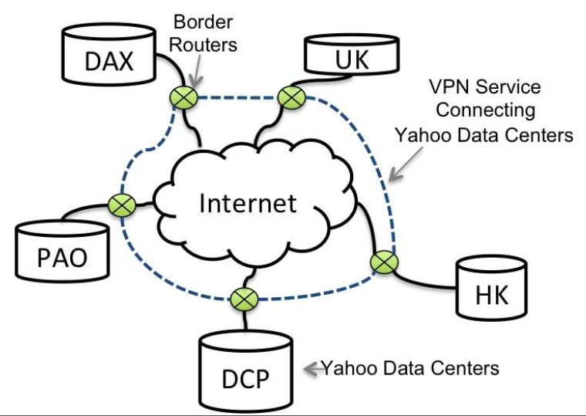
Inter-data center traffic is significant
Notes:
5 big yahoo data centers. There is certainly a larger number now, although this study is from 2011.
Study based on anonymized traces from border routers. Traffic classification is being done using heuristics such as which ports are used, identifying IP prefixes that communicate with large numbers of IP prefixes as Yahoo! prefixes talking to clients, etc. Nevertheless, reasonably accurate based on checking with operators at Yahoo!

Slide 11
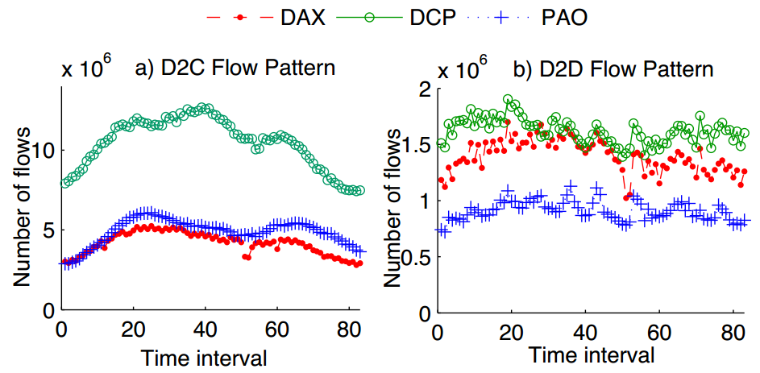
Inter-data center traffic is significant
Notes:
5 big yahoo data centers. There is certainly a larger number now, although this study is from 2011.
Study based on anonymized traces from border routers. Traffic classification is being done using heuristics such as which ports are used, identifying IP prefixes that communicate with large numbers of IP prefixes as Yahoo! prefixes talking to clients, etc. Nevertheless, reasonably accurate based on checking with operators at Yahoo!

Slide 12
Inter-data center traffic is significant
“B4: Experience with a Globally-Deployed Software Defined WAN”
Jain et al., ACM SIGCOMM 2013
“B4 has been in deployment for three years, now carries more traffic than Google’s public facing WAN, and has a higher growth rate.”

Slide 13
Why are these networks different?
dedicated,100s of Gbps
Persistent connectivity between a (small) set of end-points
Internet
(end-host to app / end-host)
Private
data center
WAN?
Design flexibility
Microsoft: “expensive resource, with amortized annual cost of 100s of millions of dollars”
[Achieving High Utilization with Software-Driven WAN, Hong et al., ACM SIGCOMM’13]
Notes:
These networks are meant to provide persistent connectivity between a fixed set of end-points. In many instances, the number of end-points may be in the 10s. (Of course, CDNs like Akamai have a much larger footprint.)
Network design freedom is quite limited on the Internet: wide co-ordination between independent parties
Private data centers provide the highest flexibility in design
For WANs, it depends on how much of WAN is privately owned. If it’s entirely private, you may have great flexibility — your own routing, TE, your own protocols. And as we shall see, possibly even your own hardware!
If you’re dependent on transit ISPs, your control over routing is more limited, but you can still run your own transport protocols.

Slide 14
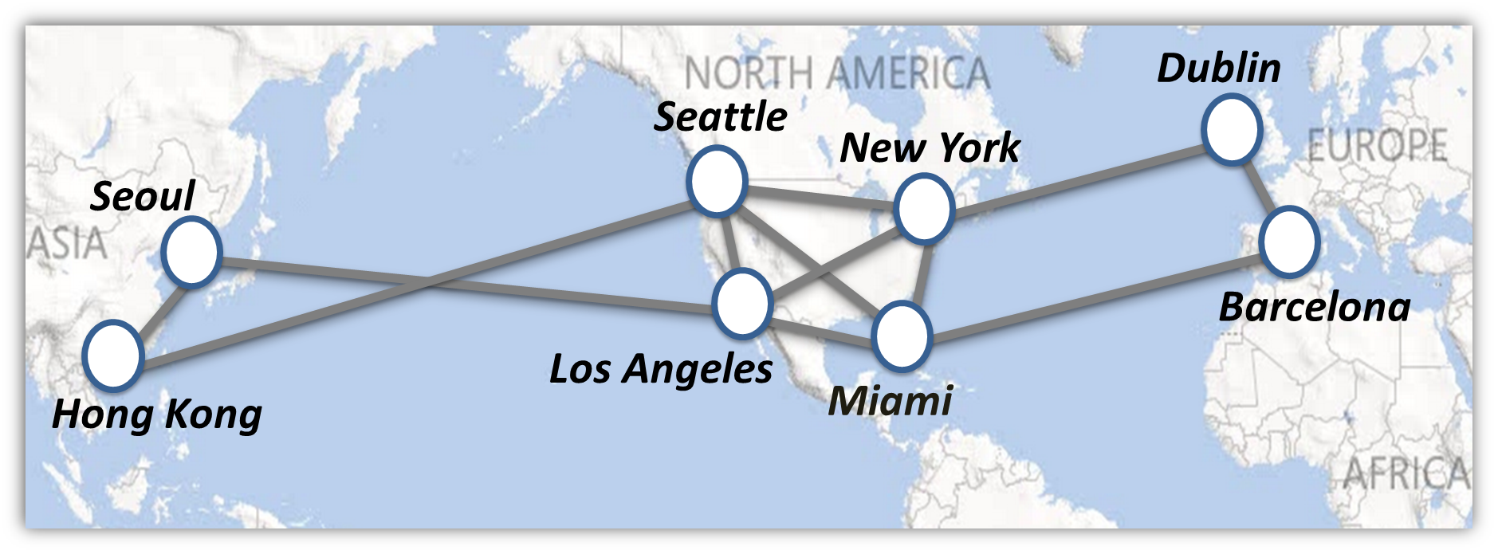

Goal of Inter-DC WAN
Increase the utilization of these links meanwhile keeping low latency
Rely on traffic engineering!

Slide 15
Traditional WAN approach: MPLS
Notes:
We’ll focus our attention on the problem of WAN TE in terms of bandwidth
We’ll talk more about latency when we discuss CDNs in another lesson
Traditional approach to TE in such networks: MPLS (multi-protocol label switching)

Slide 16
Traditional WAN approach: MPLS
1
Link-state protocol (OSPF / IS-IS)

Slide 17
Traditional WAN approach: MPLS
1
Link-state protocol (OSPF / IS-IS)
2
Also flood available bandwidth info
3
Fulfill tunnel provisioning requests
Notes:
Knowing the state of the network, when a router receives a new flow setup request, it will set up a tunnel along the shortest path on which enough capacity is available. It sends protocol messages to the routers on the path setting up this tunnel
MPLS also supports the notion of flow priorities, whereby …

Slide 18
Traditional WAN approach: MPLS
1
Link-state protocol (OSPF / IS-IS)
2
Also flood available bandwidth info
3
Fulfill tunnel provisioning requests
4
Update network state, flood info

Slide 19
Traditional WAN approach: MPLS
1
Link-state protocol (OSPF / IS-IS)
2
Also flood available bandwidth info
3
Fulfill tunnel provisioning requests
4
Update network state, flood info
Only ingress and egress read packet header
Notes:
With the routing state in place, let’s see how data packets are forwarded …
only ingress and egress … hence the label switched part of the name
MPLS can run over different protocols — as long as the ingress and egress routers are capable of matching the protocol headers to tunnel labels … hence “multi-protocol”

Slide 20
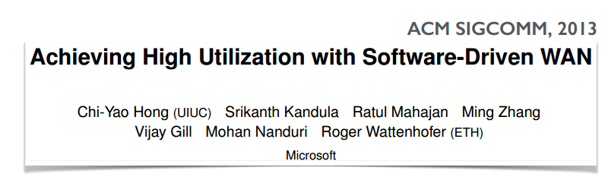
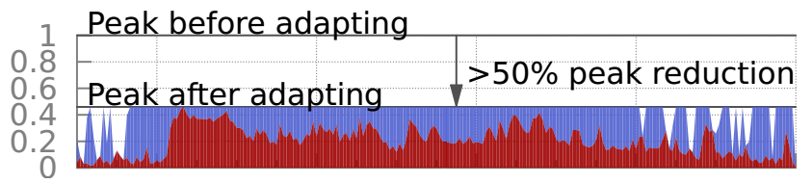
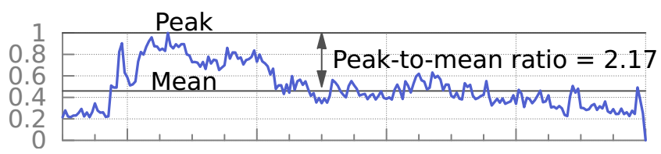
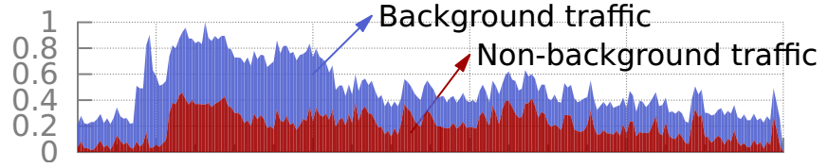
Problem 1: neglect traffic characteristics
1
Link-state protocol (OSPF / IS-IS)
2
Also flood available bandwidth info
3
Fulfill tunnel provisioning requests
4
Update network state, flood info
Utilization
Time
Notes:
low utilization of expensive WAN bandwidth
No co-ordination across services => peak provisioning
Majority of this traffic does not have a tight deadline
Distributed decision making: local, greedy
For these reasons, such networks are traditionally run around 30% util.

Slide 21
Problem 2: inefficient local allocation
B
C
D
B
C
D
A
A
E
E
H
G
F
H
G
F
Local, greedy allocation
Globally optimal allocation
[Latency inflation with MPLS-based traffic engineering, IMC 2011]
Notes:
Explain MPLS and tunnels.
Sub-optimality was observed in practice. [IMC paper]

Slide 22
Problem 3: inflexible sharing
2x the bandwidth!
Notes:
link level fairness
even that is hard to achieve with limited number of router queues

Slide 23
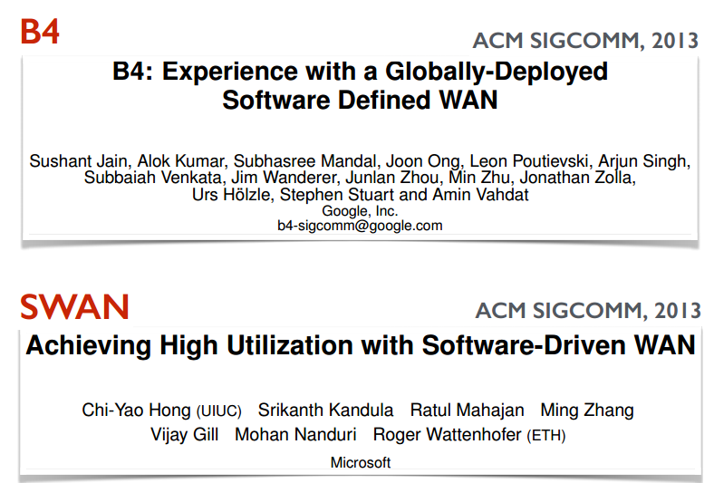
Cutting-edge WAN TE
Notes:
We discussed last time how the traditional approach to WAN TE is inefficient and inflexible because of a lack of centralized control with a visibility into the needs of different services.
These are the problems recent solutions from Google and Microsoft address

Slide 24
Common themes
1
Leverage service diversity: some tolerate delay
2
Centralized TE using SDN, OpenFlow
3
Exact linear programming is too slow!
4
Dynamic reallocation of bandwidth
5
Edge rate limiting
Notes:
Control over both network and edge is what makes this possible

Slide 25

Google’s B4
“B4: Experience with a Globally-Deployed Software Defined WAN”
Jain et al., ACM SIGCOMM 2013
First highly visible SDN success

Slide 26
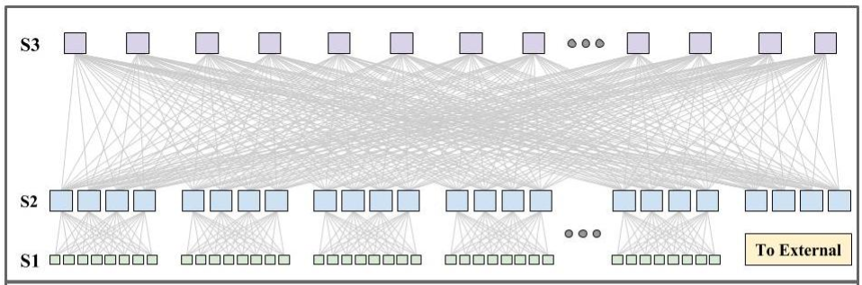

Google’s B4: view at one site
WAN routers
Data center network
Cluster border routers
BGP
BGP
Quagga
OpenFlow Controller
BGP to
other sites
BGP to
other sites
TE server
“Jupiter Rising: A Decade of Clos Topologies and Centralized Control in Google’s Datacenter Network”, Singh et al., ACM SIGCOMM’15
Notes:
The first step is merely moving routing control to software, no functional difference
Incremental approach possible: other sites should see no difference!
Lots of work went into the interface between quagga and the OFC
Now add TE with OpenFlow!

Slide 27
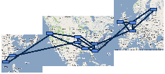
Google’s B4: Traffic engineering
TE server
Notes:
All sites connect to TE server

Slide 28
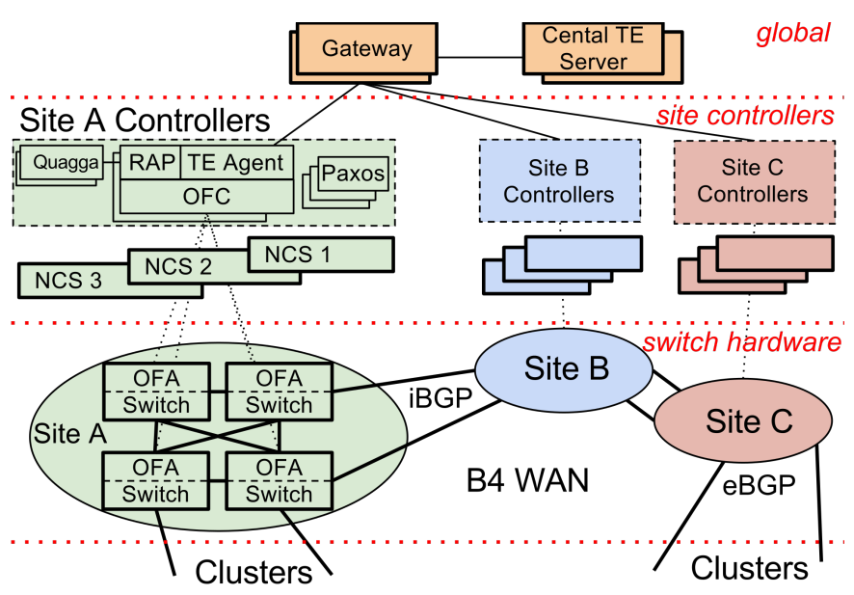
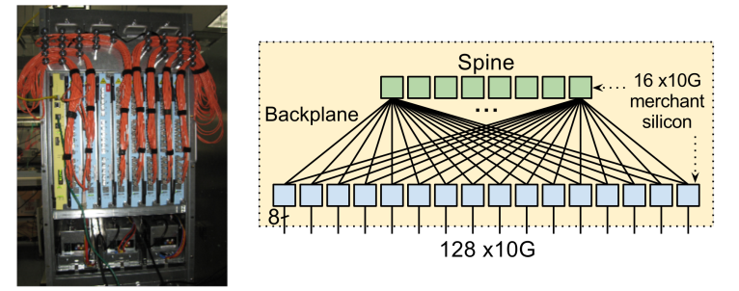
Google’s B4
“B4: Experience with a Globally-Deployed Software Defined WAN”
Jain et al., ACM SIGCOMM 2013
BGP routing as “big red switch”
Hardware: custom, cheap, simple
Software: smart, with safeguards
Hierarchy of controllers
Aggregation: flow groups, link groups
Nearly 100% utilization, 0.3s TE solution
Notes:
BGP backup: lower priority forwarding rules
Hardware: focus on forwarding
Big fwd tables, deep buffers => expensive
edge-based rate limiting => shallow buffer OK
small set of locations => small fwd table OK
simple sw software => highly available without expensive proprietary software
high radix? knew how to solve that issue!! (Remember our topology lessons?)
Keep in mind that things may have changed. Higher density sw?
sw runs linux on an embedded chip. Runs modified OpenFlow to talk to controller
Software:
Controller at each site replicated using Paxos
Hierarchy of controllers (explain rough workflow)
Other scaling tricks: aggregate flows, aggregate links
Heuristic algorithm for bandwidth assignments
Too many details to discuss here!
SWAN tackles one interesting problem B4 doesn’t: congestion free updates (not discussing here)

Slide 29
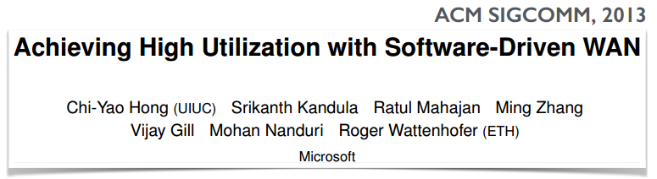
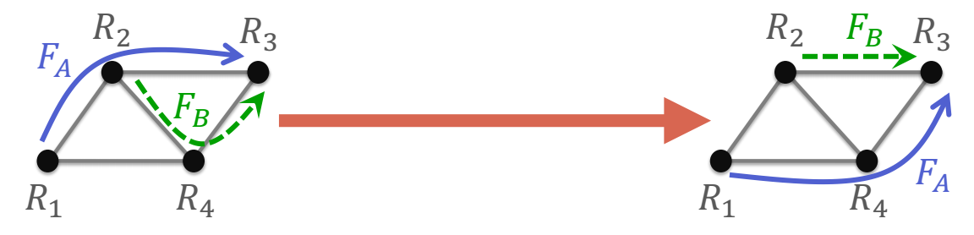
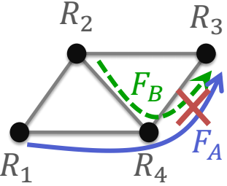
Microsoft’s SWAN
Notes:
Network updates are not “atomic”
How to transition without packet loss?
If you’re curious, refer to their paper!!

Slide 30


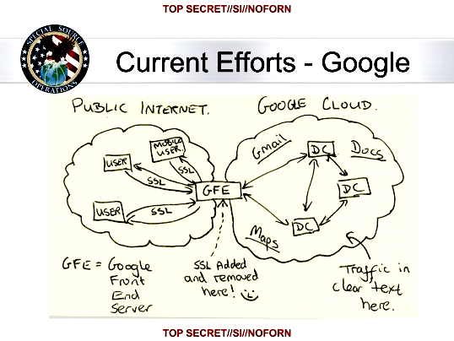
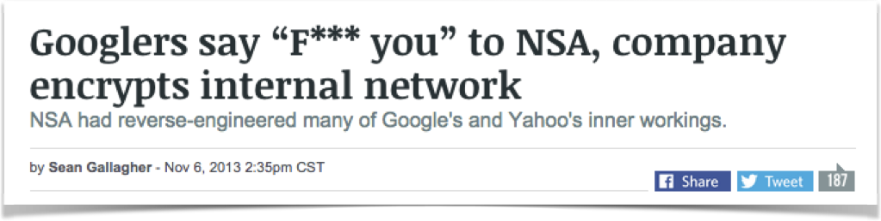
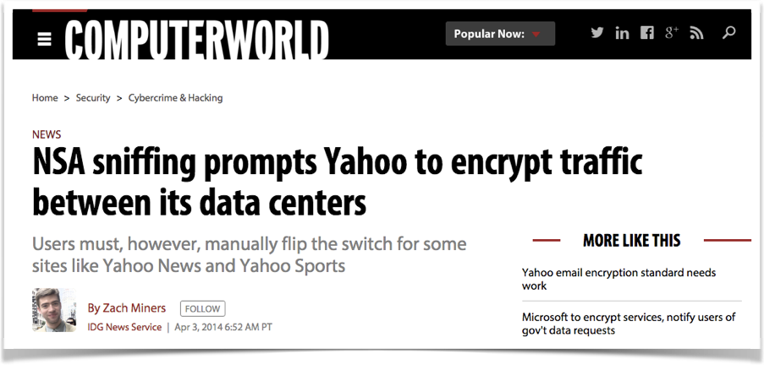
What’s more about inter-DC WAN?
Notes:
Image is public domain: https://commons.wikimedia.org/wiki/File:NSA_Muscular_Google_Cloud.jpg

Slide 31
Thanks!
陈果 副教授
湖南大学-信息科学与工程学院-计算机与科学系
邮箱：guochen@hnu.edu.cn
个人主页：1989chenguo.github.io
https://1989chenguo.github.io/Courses/CloudComputing2018Spring.html

